Slide 1
Planning :
Most important function.
Referred to “deciding in advanced” as to do what, how, when and who?
An intellectual process.
Planning involves
Selection of objects and goals
Determines the ways and means of achieving them.

Slide 2
Planning :
Any planning involves four essential qualities:
It must contribute to accomplish purpose or objective.
It must be considerate as parent exercise in all process.
It must spread through all management functions, and
It must be efficient in such a manner so as to achieve the designed goal at the least cost.

Slide 3
Importance of Planning :
Planning is important because:
It overcomes uncertainty and changes and minimizes risk. It provides:
Vital role in decision making in complex situation.
Logical facts and procedures.
It facilitates effective control:
Sets goals, targets and means to accomplish the goals.
Goals or plans become Standards or Bench marks.

Slide 4
Importance of Planning :
It focuses attention and concentration only on the objective of enterprise:
Helps manager and entire organization to work, focus on goals and activities of organization.
It makes economic operation and leads to success:
Does not ensure success, but leads to success.
Plan in advance ➔ no confusion in achieving goals.
It forms the bridge between the present and future:

Slide 5
Planning :
Selecting missions and objectives as well as the actions to achieve them, which requires decision making, that is, choosing a course of action from among alternatives.
Fig. : Close relationship of planning and controlling

Slide 6
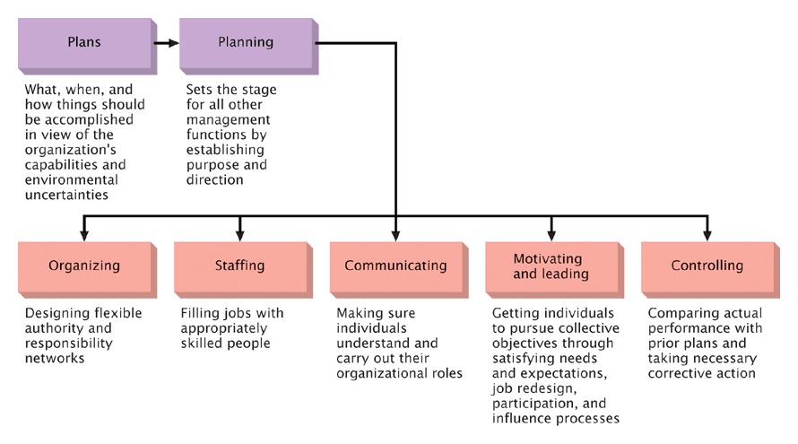
Planning: The Primary Management Function
Planning and Control are Siamese twins of Management (Planning and Control are Inseparable)

Slide 7
Purpose of Planning
Because of changes in the environment
Set the standards to facilitate control
Provide direction
Managers engage in planning to:
Minimize waste and redundancy
Reduce the impact of change
Prentice Hall, 2002

Slide 8
Purpose of Planning
Allows decisions to be made ahead of time.
Permits anticipation of consequences.
Provides direction and a sense of purpose.
Provides a unifying framework; avoiding piecemeal decision making.
Helps identify threats and opportunities and reduces risks.
Facilitates managerial control through the setting of standards for monitoring and measuring performance.

Slide 9
Sets Standards to
Facilitate
Control
Provides
Direction
Reasons
for Planning
Minimizes Waste
and Redundancy
Reduces the
Impact of Change
Notes:
5
Planning can be either formal or informal, depending on the time frame and amount of documentation. Because of the dynamic and unpredictable business environment, it is important that managers plan and plan well. There are four reasons for planning.
First, planning coordinates effort by giving direction to managers and non-managers.
Second, planning reduces uncertainty by forcing managers to look ahead, anticipate change, and develop appropriate responses.
Third, planning reduces redundancy.By coordinating efforts, wasteful and inefficient activities can be prevented.
Fourth, planning establishes standards or objectives that facilitate control over the process of achieving goals.

Slide 10
Criticisms of
Formal
Planning
May Create
Rigidity
Can’t Be Done in a
Dynamic Environment
Can’t Replace Intuition
and Creativity
Focus on Today’s
Competition
Reinforces
Success
Notes:
6
Formal planning has been popular in business since the 1960s, but there have been criticisms of the process.
• Planning may create rigidity. Assuming that conditions will remain relatively stable, formal plans lock organizational units into specific goals and time frames.
• Plans can’t be developed for a dynamic environment. Managing chaos and turning disasters into opportunities requires flexibility, not rigid, formal plans.
• Formal plans can’t replace intuition and creativity. Developing strategy depends as much on intuition and creativity as it does on formal analysis. Because most successful strategies are visions, not plans, merely following a systematic framework will not yield incisive thinking.
• Planning focuses a manager’s attention on today’s competition, not on tomorrow’s survival. Formal planning stresses capitalizing on existing opportunities, not reinventing or creating an industry.
• Formal planning reinforces success, which may lead to failure. Success can breed failure. Since change is motivated by problems, success may not motivate managers to challenge the status quo.

Slide 11
Types of Plans :
Plans can be classified as
Missions or purposes,
Objectives or goals,
Strategies,
Policies,
Procedures,
Rules,
Programs, and
Budgets.

Slide 12
Mission or purpose :
The basic purpose or function or tasks of an enterprise or agency or any part of it.
Purpose of planning are listed below:
To select alternatives to achieve objectives efficiently
Direct all functions of managements
To set up goals within environment
To helped planned goals to break-up into more easier subparts.
To form basic budget.
To forecast the future to avoid uncertainty and change.
To provide efficient control

Slide 13
Objectives or Goals :
The ends toward which activity is aimed.
The following are some of the requirements of a good objectives:
Objectives must be clear and must be acceptable.
The objective must support on another.
The objective must be precise.
The objective must be measurable
The objective must be realistic and valid ones.

Slide 14
Strategies :
The determination of the basic long-term objectives of an enterprise and the adoption of courses of action and allocation of resources necessary to achieve these goals.
Policies :
General statements or understandings that guide or channel thinking in decision making.
Procedures : Procedures are plans that establish a required method of handling future activities. They are chronological sequences of required actions.

Slide 15
Rules : Rules spell out specific required actions or nonactions allowing no discretion. The essence of a rule is that it reflects a managerial decision that a certain action must or must not be taken.
Programs: Programs are a complex of goals, policies, procedures, rules, task assignments, resources to be employed, and other elements necessary to carry out a given course of action.
Budget : It is a statement of expected results expressed in numerical terms. It may be a quantified plan.

Slide 16
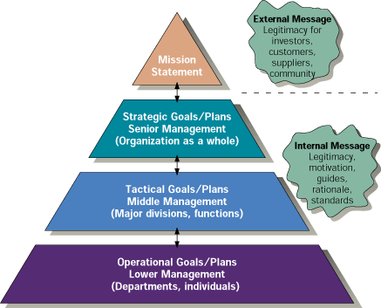
Levels of Goals/Plans

Slide 17
Steps in Planning
Fig. : Steps in planning

Slide 18
Being Aware of Opportunities
Establishing Objectives
Developing Premises
Premises : Assumptions about the environment in which the plan is to be carried out.
Principle of planning premises : The more thoroughly individuals charged with planning understand and agree to utilize consistent planning premises, the more coordinated enterprise planning will be.
Determining Alternative Courses
Evaluating Alternative Courses
Selecting a Course
Formulating Derivative Plans, and
Quantifying Plans by Budgeting

Slide 19
Decision Making

Slide 20
Decision Making
The selection of a course of action from among alternatives. It is at the core of Planning.
The Importance and Limitations of Rational Decision Making
The process leading to making a decision might be thought of as
1. Premising: locating the area of decision making
Identifying alternatives,
Evaluating alternatives in terms of the goal sought, and
Choosing an alternative, that is, making a decision.

Slide 21
Rationality in Decision Making:
- Based on Logic or Reasons
Limited, or “Bounded”, Rationality
Satisficing Picking a course of action that is satisfactory or good enough under the circumstances.
Development of Alternatives and the Limiting Factor
Principle of the limiting factor: By recognizing and overcoming factors that stand critically in the way of a goal, the best alternative course of action can be selected.

Slide 22
Evaluation of Alternatives
Quantitative and Qualitative Factors
Quantitative factors Factors that can be measured in numerical terms.
Qualitative, or intangible, factors Factors that are difficult to measure numerically.
Marginal Analysis
Evaluating alternatives may involve marginal analysis. It is “Comparing the additional revenue and the additional cost arising from increasing output”.
Cost-Effectiveness Analysis
Seeks the best ratio of benefit and cost.

Slide 23
Selecting an Alternative : Three Approaches
When selecting from among alternatives, managers can use three basic approaches :
Experience,
Experimentation, and
Research and Analysis.

Slide 24
Figure 1 : Bases for selecting from among alternative courses of action

Slide 25
Experience:
Experience is the BEST Teacher.
Many managers rely on their past experience.
Relying on the past Experience for future actions can be dangerous. Because
Most managers do not recognize the underlying reasons for their success or failures, and
The lessons of experience may entirely inapplicable to new problems.

Slide 26
Experimentation
An obvious way to decide among alternatives is to try one of them and see what happens.
The experimental technique is likely to be the most expensive of all techniques.
Research and Analysis
A major step in the research-and-analysis approach is to develop a model simulating the problem.

Slide 27
Programmed and Nonprogrammed Decisions
Programmed decisions are used for structured or routine work.
Nonprogrammed decisions are used for unstructured, novel, and ill-defined situations of a nonrecurring nature.
Figure 2 : The nature of problems and decision making in the organization

